Slide 1
Design of an Efficient Multicast Protocol for IEEE 802.11n WLANs
Ahmed Mehfooz, Amna Abid, Shanzae Nadeem Khan

Slide 2
Background Motivation
Multicast is an efficient way to broadcast a single packet to multiple receivers – unnecessary packet duplications are avoided.
Multicast has some limitations:
Packets only sent on base rate – low overall throughput
Not reliable due to the absence of a feedback mechanism
Inefficient due to lack of frame aggregation since no feedback available
Tradeoff between reliability and performance
Higher reliability -> Increased feedback -> Increased overhead
Reduced feedback -> Decreased overhead -> Improved performance
Our Goal: Maximize performance while incurring minimum overhead

Slide 3
Milestones: Fall Semester
Month | Deliverable
October | Literature Review Brainstorming on possible solutions
November | Driver Code Evaluation Test-Bed Setup Experiments to Evaluate stock 802.11n Multicast Performance
December | Exploring for the most viable method to passively get feedback from receivers. Will require extensive experiments on the test-bed and driver code analysis. (Proved unsuitable – new approach needed to be adopted.)

Slide 4
Milestones: Spring Semester
Month | Deliverable
February | Developing a viable feedback mechanism to provide rate control for multicast transmissions using hooking.
March | Developing the Rate Adaptation Protocol using probing.
April | Developing the Leader Selection Protocol using the ACK overhearing method.
May | Carrying out experiments to observe the magnitude of improvement in multicast transmissions by implementing the aforementioned protocols in multicast 802.11.

Slide 5
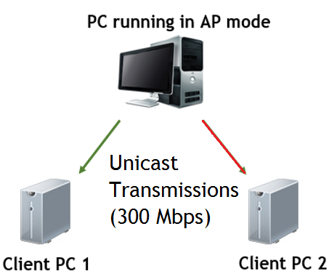
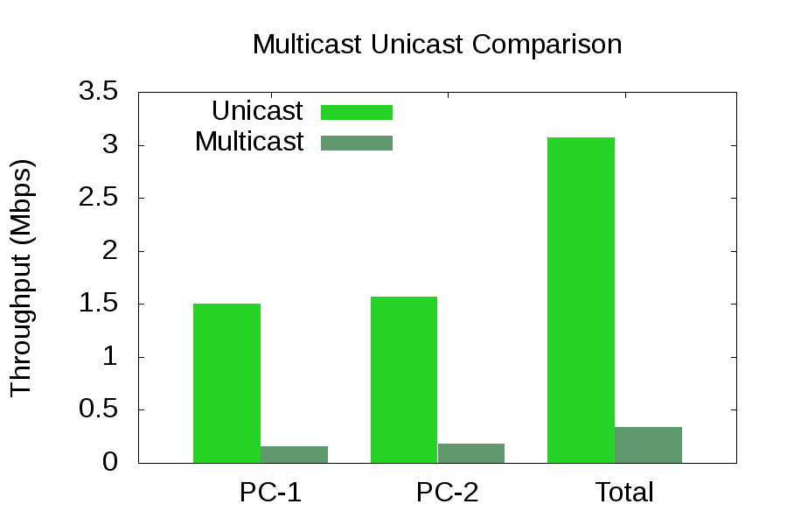
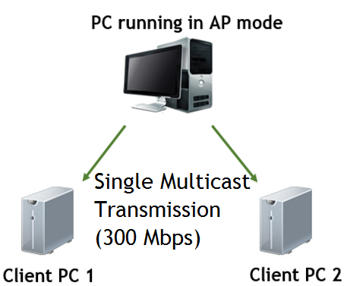
Experiments to evaluate stock 802.11 multicast performance

Slide 6
Implementing a Viable Feedback Mechanism
Hooking – method of code injection in an active LINUX kernel
Our Hook:
Sits between the Physical Layer and Wireless Driver
Intercepts packets associated with a single multicast group
Periodic feedback response from the receivers containing PER and RSSI values
Entire packet must be manually crafted – requires meticulous handling of fields e.g. MAC Addresses and IP Addresses

Slide 7
How the kernel module works:
Craft UPD Header
Hook Registered
Add Feedback Information
Does the Dest. IP Address of the packet match the address of our multicast group?
Craft IP Header
Craft Ethernet Header
Handover Packet to Driver for Transmission Using dev_queue_xmit()
Send Feedback

Slide 8
Client Module

Slide 9
Server Module

Slide 10
Rate Adaptation Algorithm

Slide 11
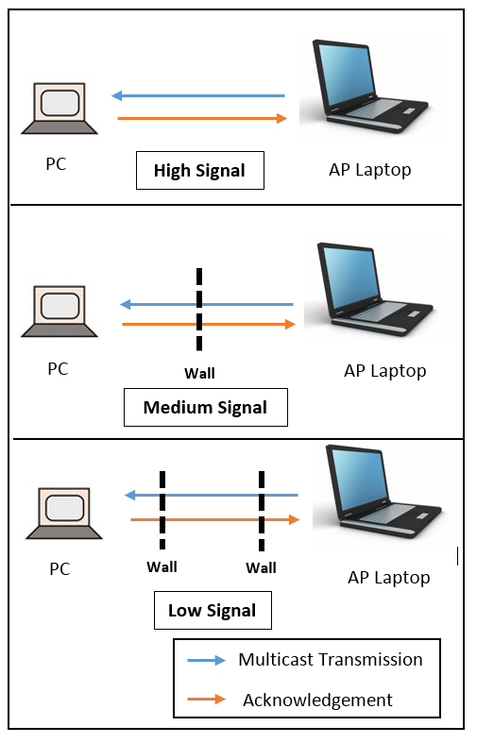
Experimental Setup
Tested our protocol in three different scenarios with varying signal strengths:
High signal
Medium signal
Low signal

Slide 12
Future Venues

Slide 13
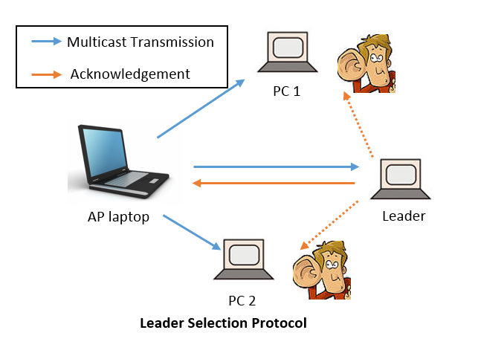
Leader Selection Protocol (The Topology)
Novelties:
New method of Leader Selection
Entirely distributed – no dependence on the AP

Slide 14
Leader Selection Protocol (The Algorithm)

Slide 15
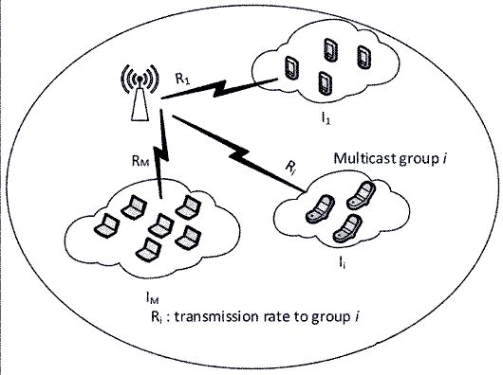
Future Venues
Split Receivers into separate groups according
to link quality
Use different transmission rates for each group
Further optimization of the Leader Selection Protocol
Increased Scalability
Dealing with the Hidden Node Problem – Implicit overhearing of the leader’s ACKs by any distant node
Further optimization of the Kernel Module
Directly utilizing MAC Layer ACKs instead of UDP sockets for sending feedback

Slide 16
Related Works
Multicast
Protocols
Leader-based
SRM(Semi Reliable Multicasting)
ACK-Based
Non-leader-Based
ACK-Based
NACK-Based
NACK-Based
REMP(Reliable and efficient Multicast Protocol)
DPMM(Double Piggyback Mode Multicast)
Adaptive Multicast Services
(e.g.)
(e.g.)
(e.g.)
(e.g.)

Slide 17
Thank You

